Slide 1
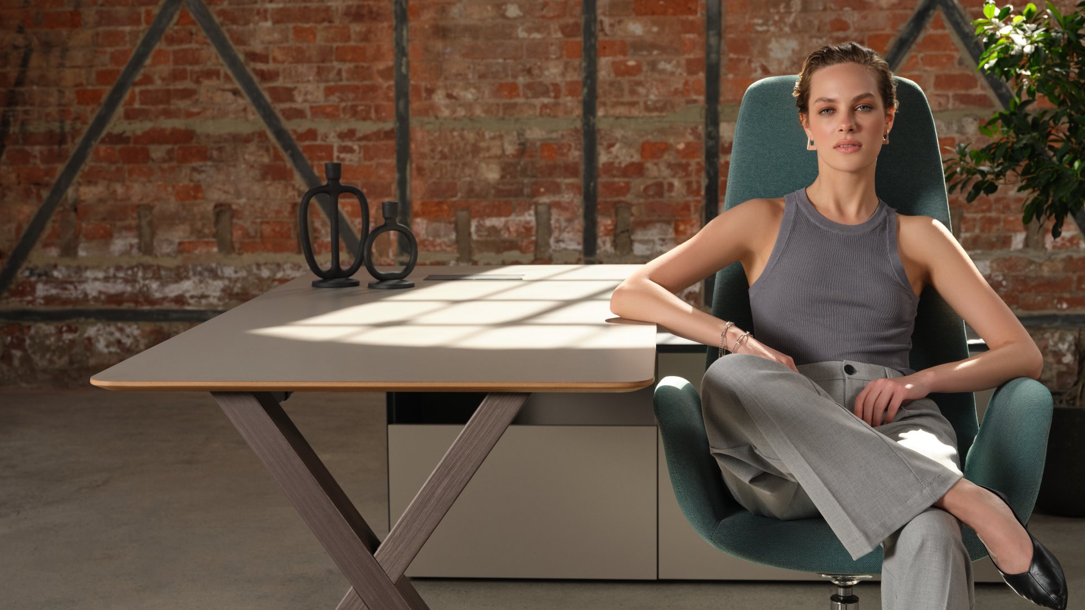
MOMENTS
OF LIFE

Slide 2
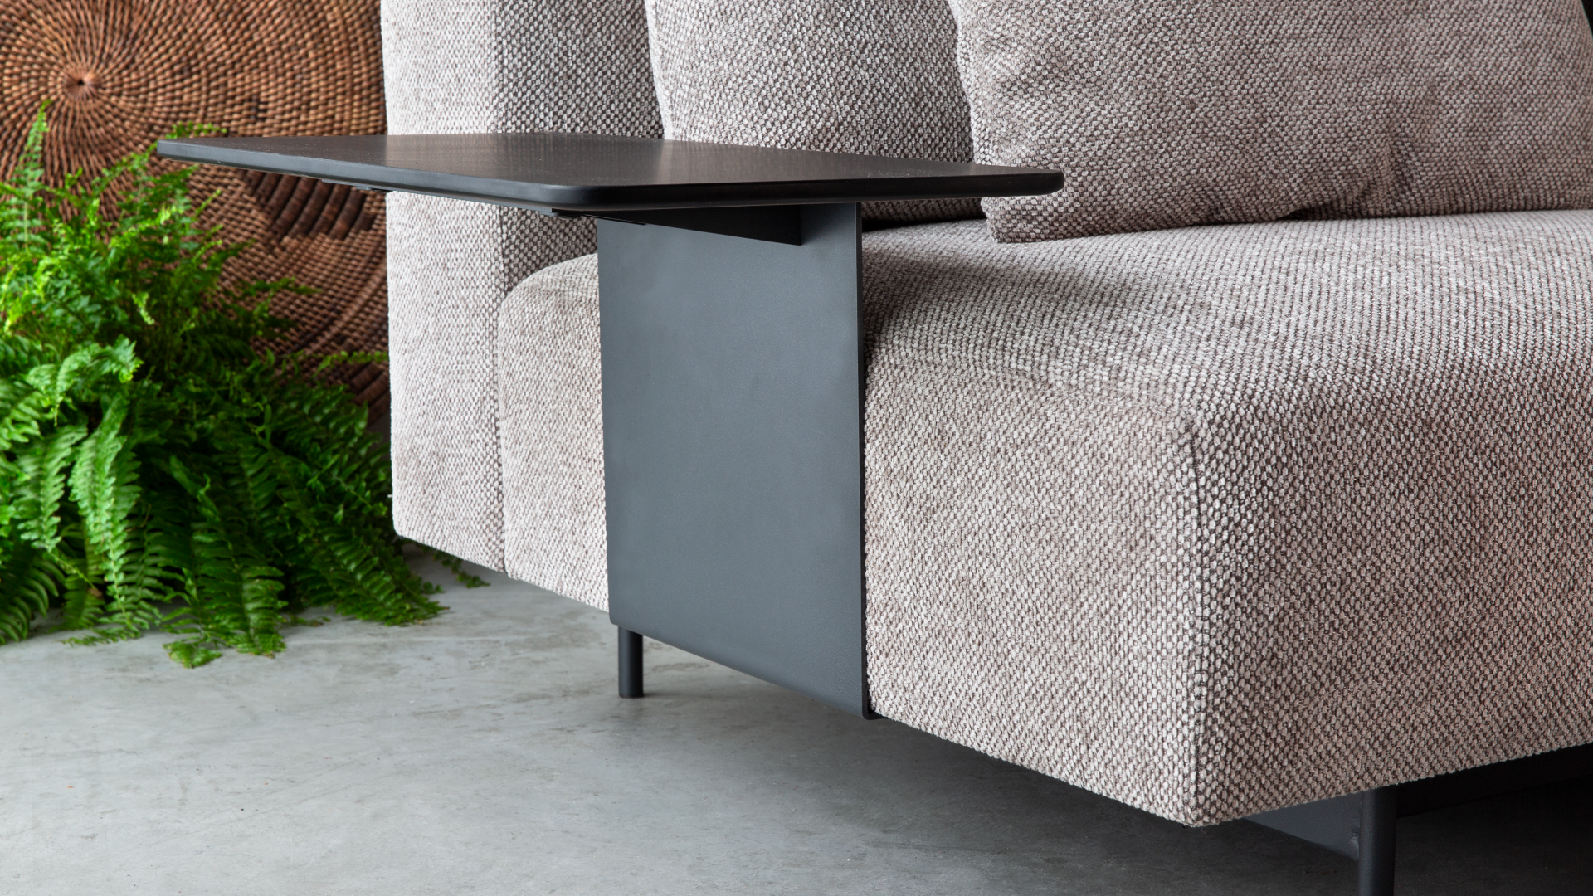
Crafting
good design
for 50 years
Founded by architect Faruk Malhan in 1972, Koleksiyon’s
design culture shapes the future with the strength it
draws from its tradition, boldly pioneers innovation
and continues its journey with the dream of a better world.

Slide 3
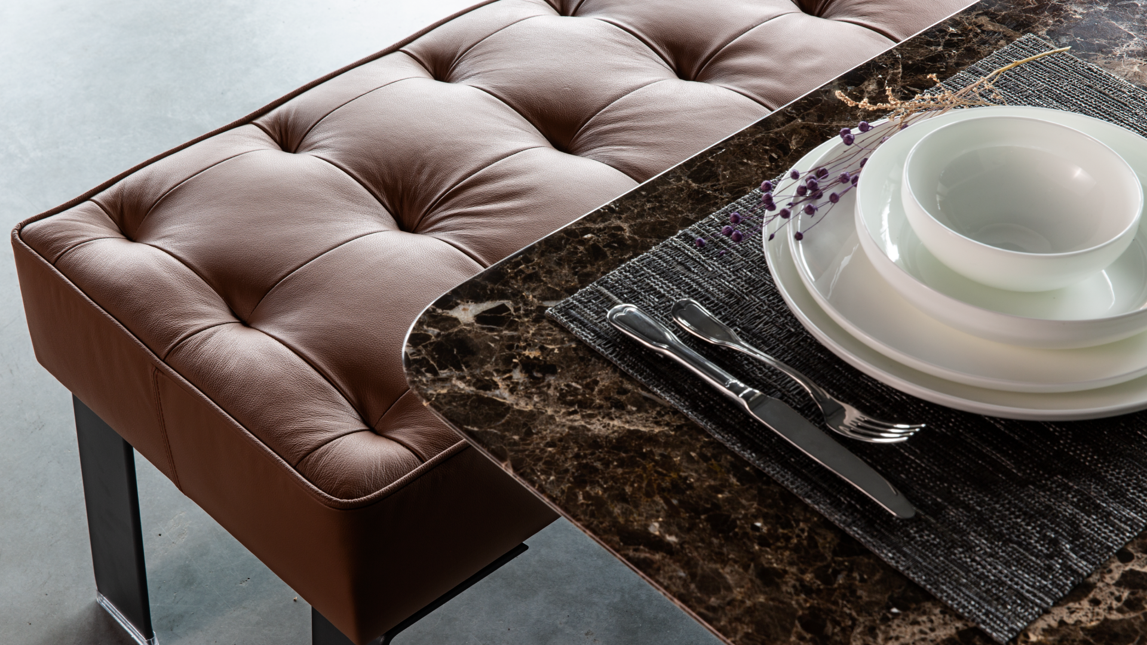
Giving life to
unique furniture
and accessories
The company is excelling in the latest production technologies, exploring new frontiers in
contemporary design and searching new materials, forms and colors.

Slide 4
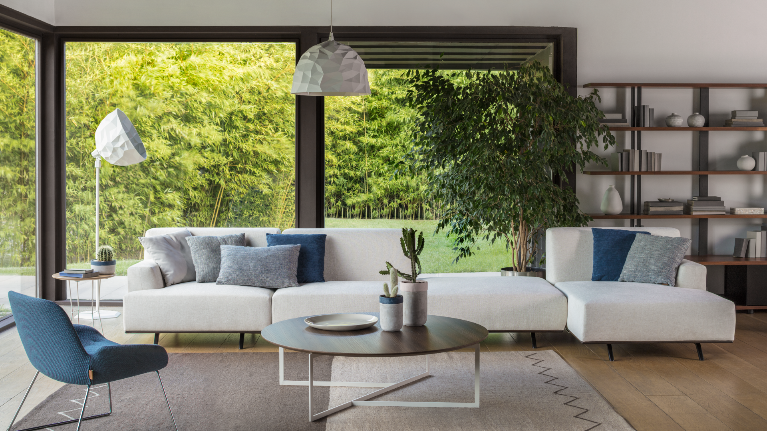
Pioneering
contemporary
design for
50 years
Koleksiyon has not only made the
dream of “establishing an industry
serving design” a reality, but has
transformed its unique design
language, superior quality
products and people-oriented
approach into a brand respected
by millions on 5 continents.

Slide 5
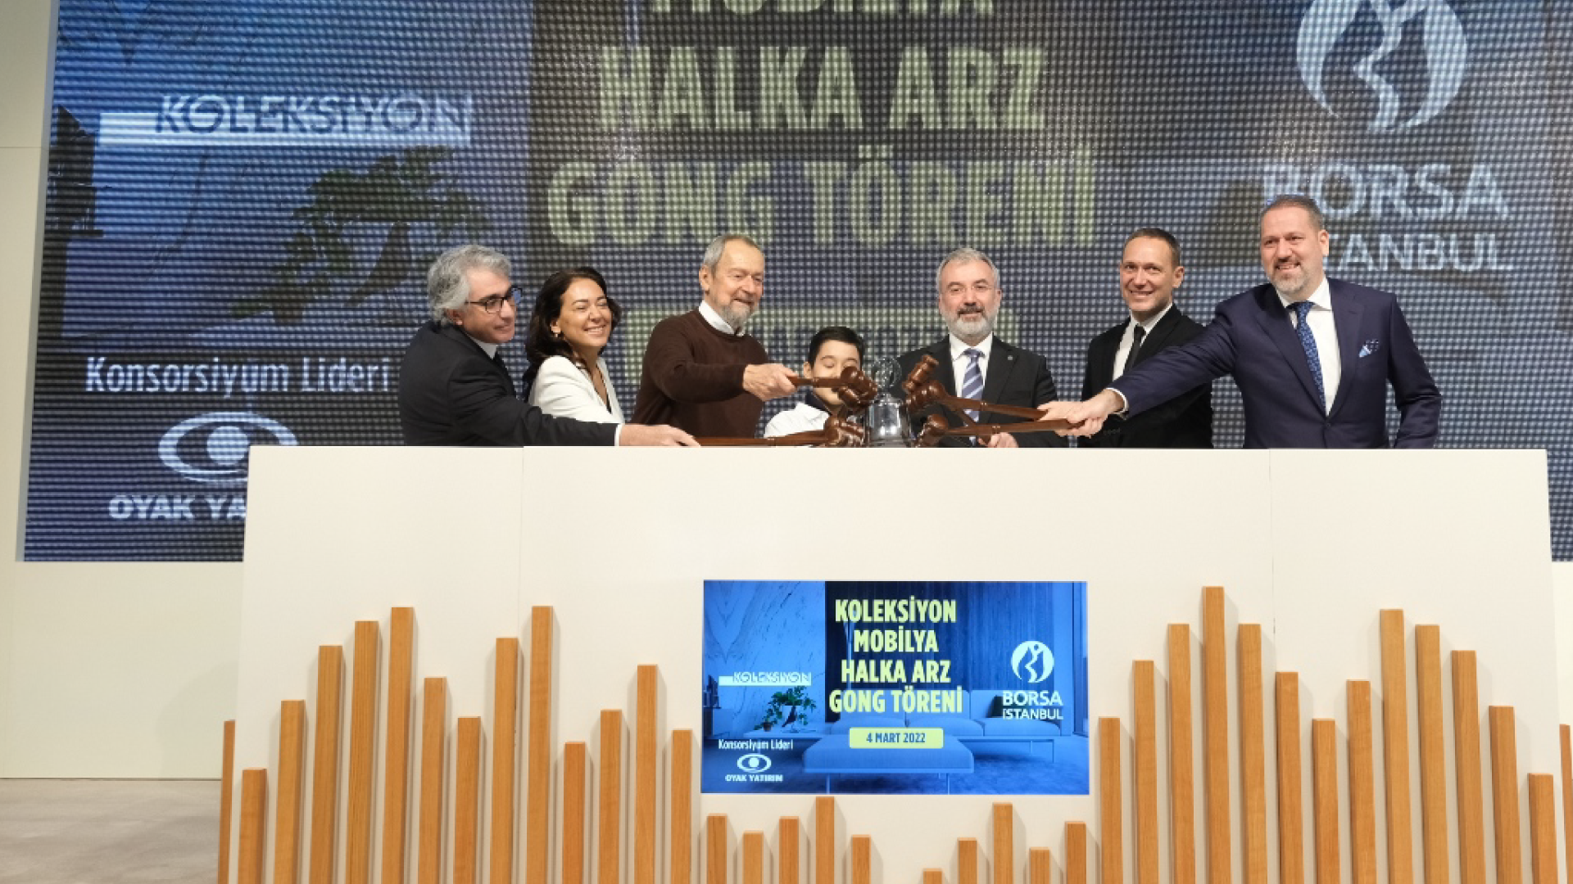
A new
corporate
dimension
Koleksiyon, going public in 2022 after a successful
launch program in the Istanbul Stock Exchange, is
proud of transforming form a 50-year-old family business to a large corporation
Ticker code: KLSYN

Slide 6
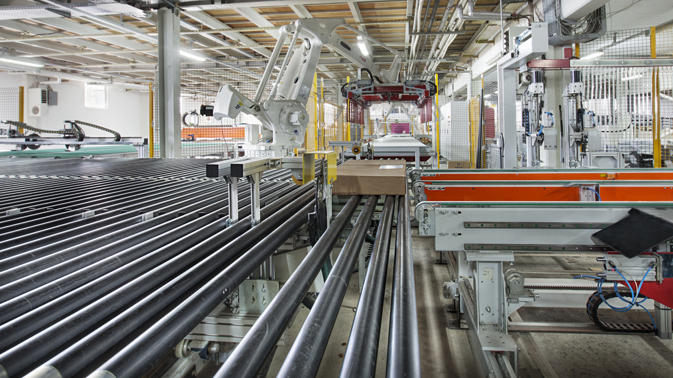
Fifty years
of being
innovative
every day!
Koleksiyon has been on the quest
for good design for 50 years, with
mastery, care, attention to the
smallest detail, and always an excruciating
passion for perfection.

Slide 7
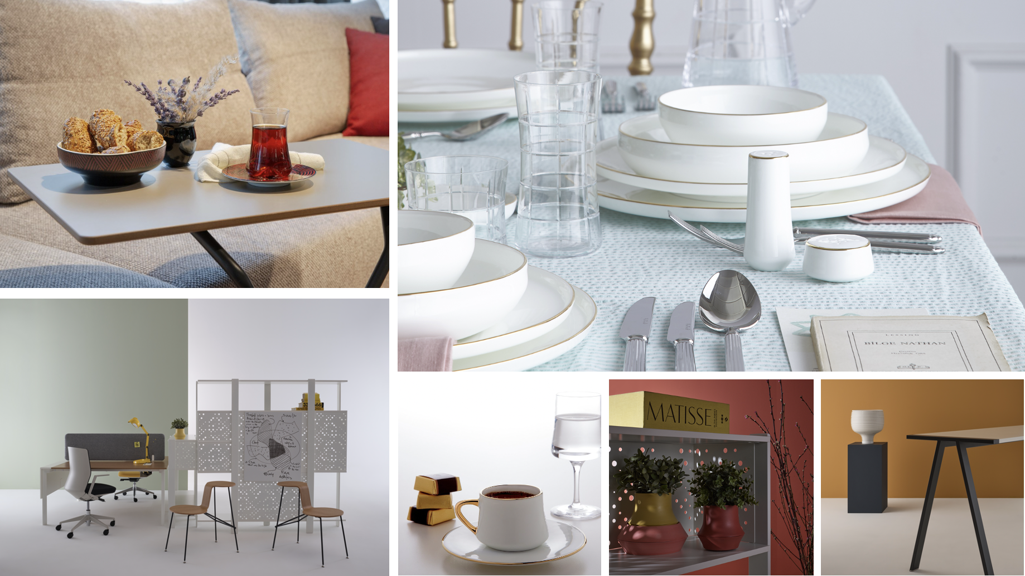
Offering
a wide range
Developing original furniture and
accessories; Koleksiyon currently
offers a wide range of designs
including office, commercial and
residential furniture, tableware,
glassware, jewelry, textile and
decorative items.

Slide 8
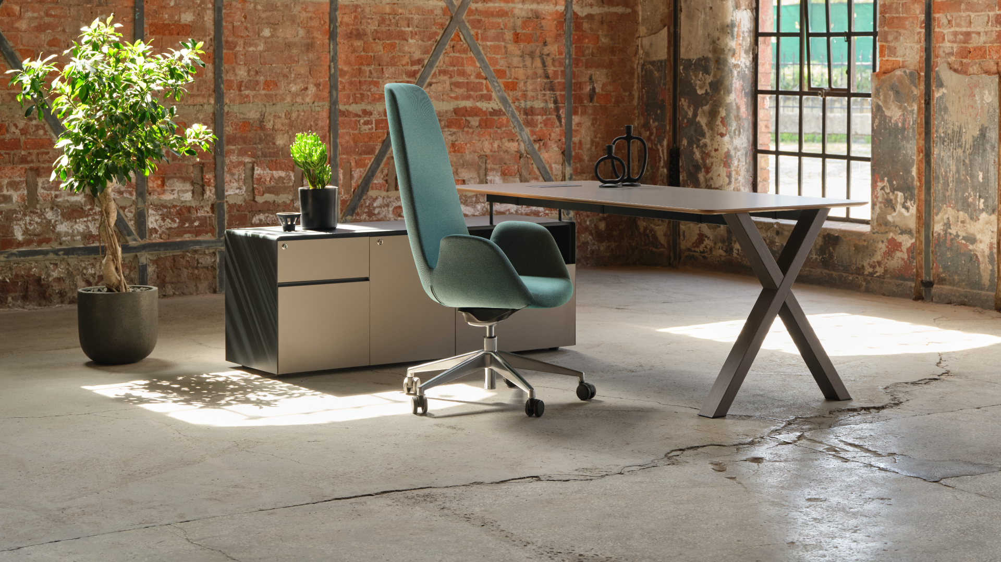
Global designer
collaborations
Koleksiyon has been pioneering
contemporary design for 50 years,
collaborating with world-class
designers and adding value to
living spaces in 33 countries, with
the signature of Koleksiyon on
iconic projects form New York to
Paris, from London to Istanbul.

Slide 9
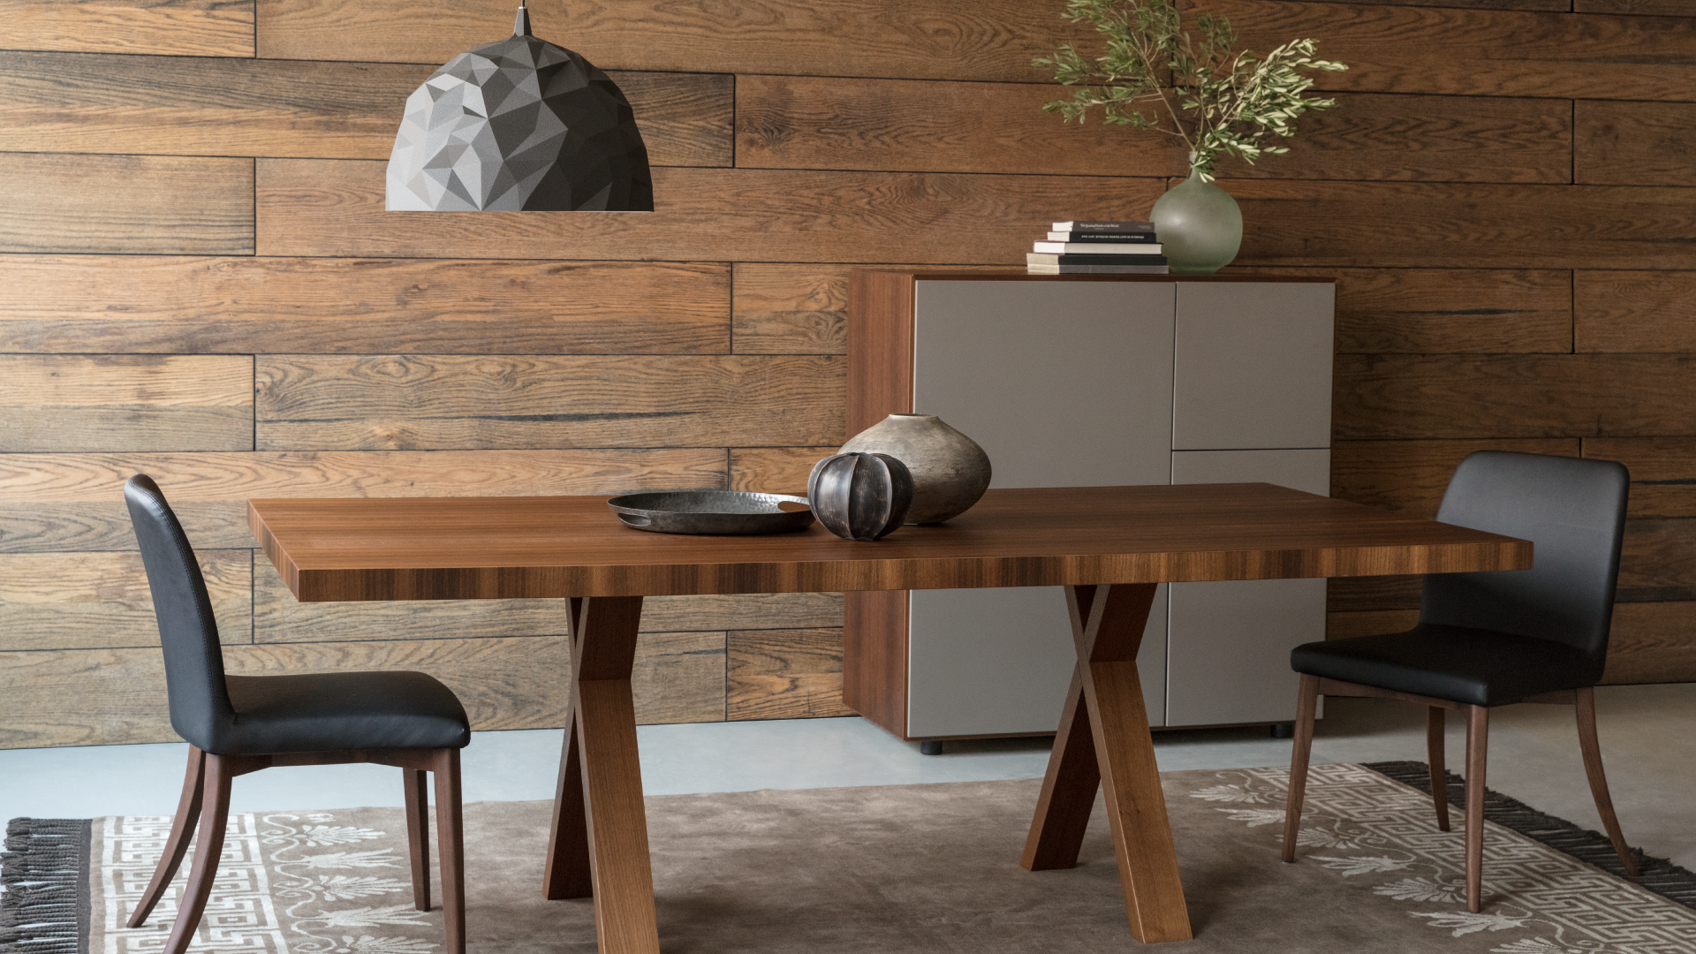
Thinking
circular
Here at Koleksiyon, we design, we
produce, we us circular.
think
circular
In all levels of our value chain, we
act protecting our resources,
caring environment, eliminating
waste and saving energy.

Slide 10
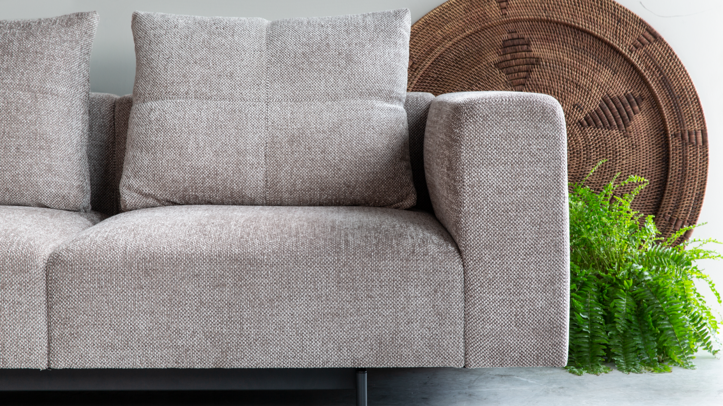
Energy saving precautions are taken and low energy equipment are used in all departments and units.
Recycled material is preferred in wherever applicable.
No hazardous chemicals are used in any stage of lacquering and epoxy coating.
Caring for the
environment
All dyes and paints used in the production are water based
and soluble.
All the wastes from any stage of the production are separated and disposed in 25 different categories.
One biological and one chemical filtering system is
operating within the factory.
All wastes are collected by expert companies registered to the Ministry of Environment in line with regulations.

Slide 11
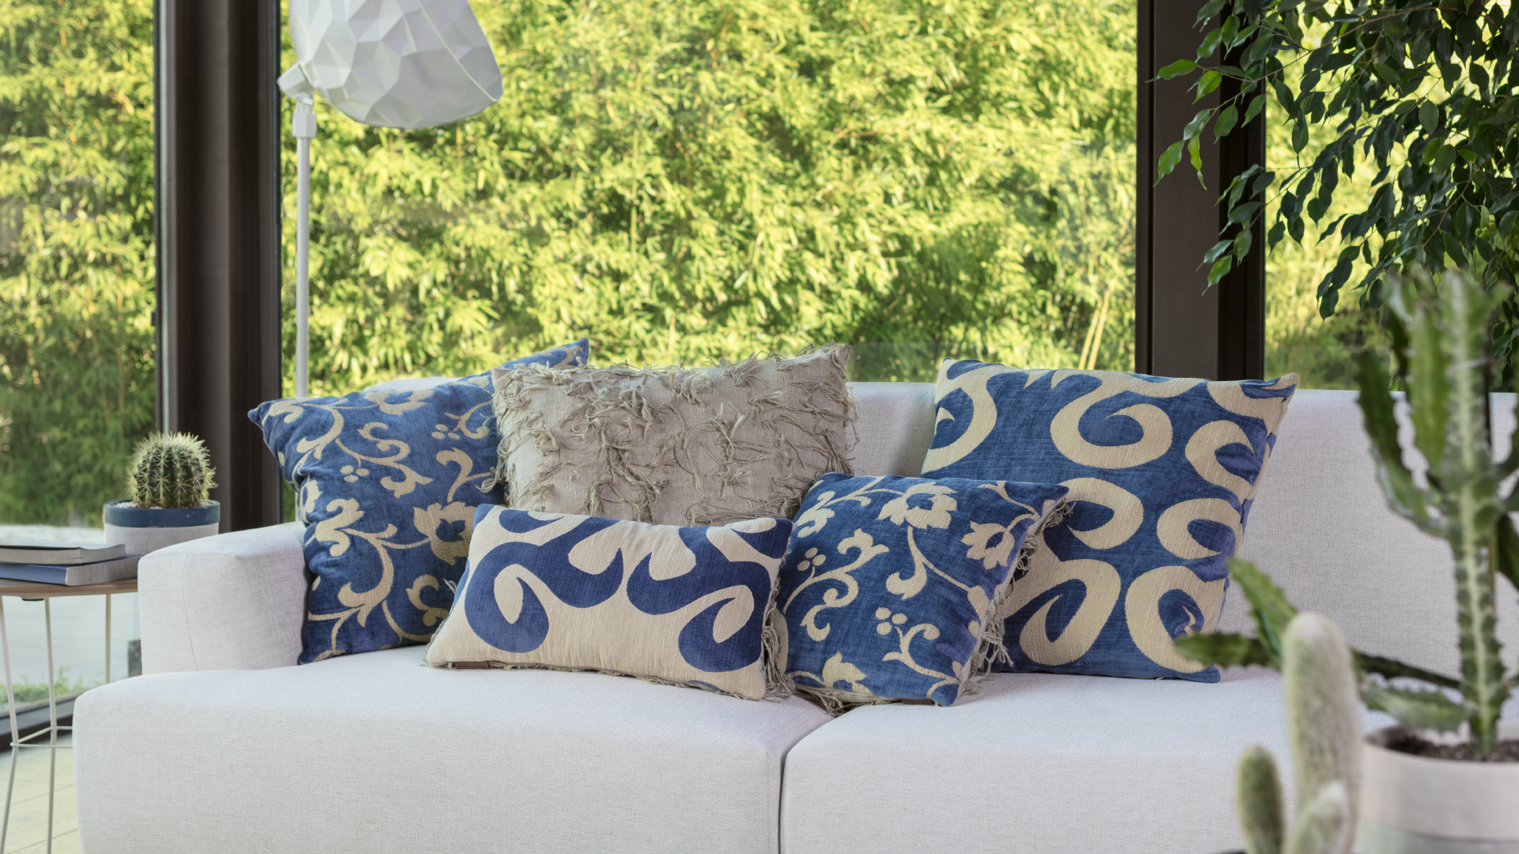
Respecting nature
We make sure that our designs are long-lasting, respectful to nature and reusable. In our production, we minimize our waste with nature-friendly business processes and reduce our carbon footprint. We use recycled and/or recyclable materials always caring about the sustainability of global resources.

Slide 12
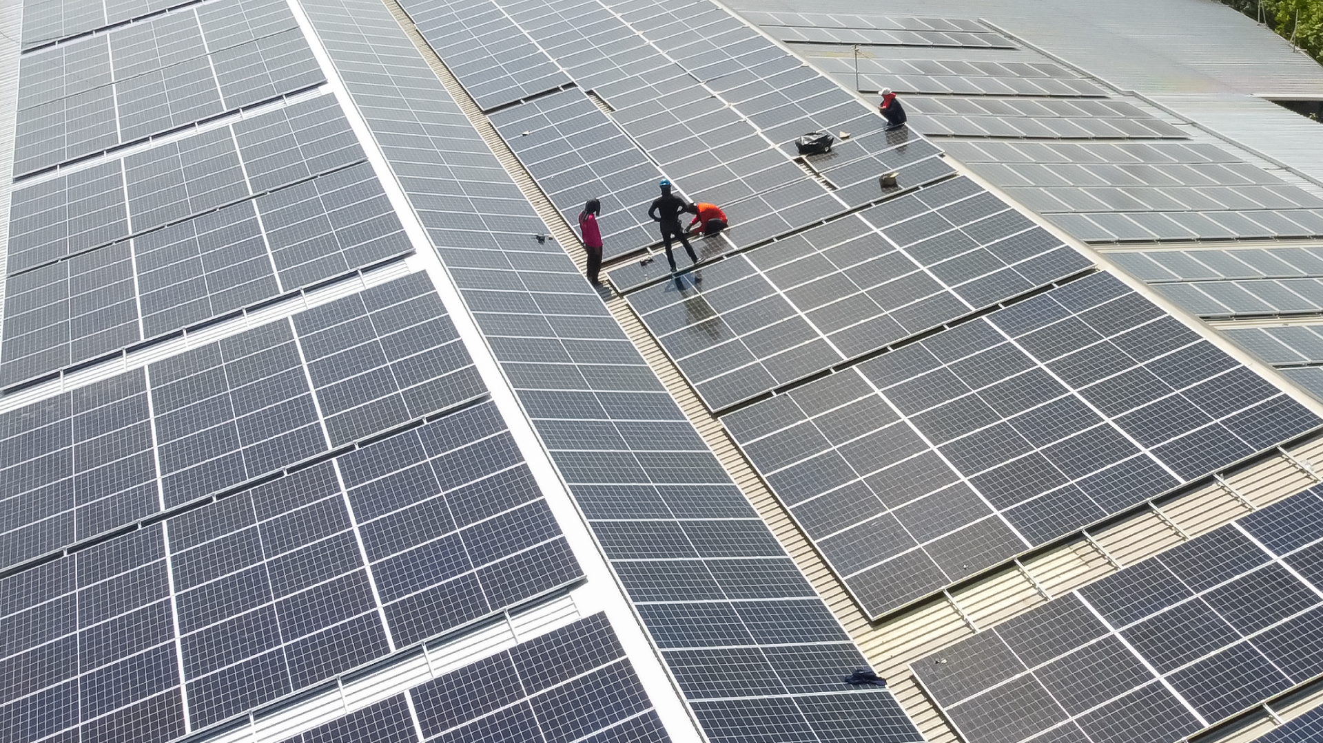
Investing in solar, accelerating the use of renewables
Seeking to place its energy system on a sustainable footing, Koleksiyon is establishing solar energy panel system to meet the energy need at Tekirdağ Factory.
On 20.000 m2
4,760 panels solar roof
1,980 kWE / AC
2,570.4 kWP / DC installed power

Slide 13
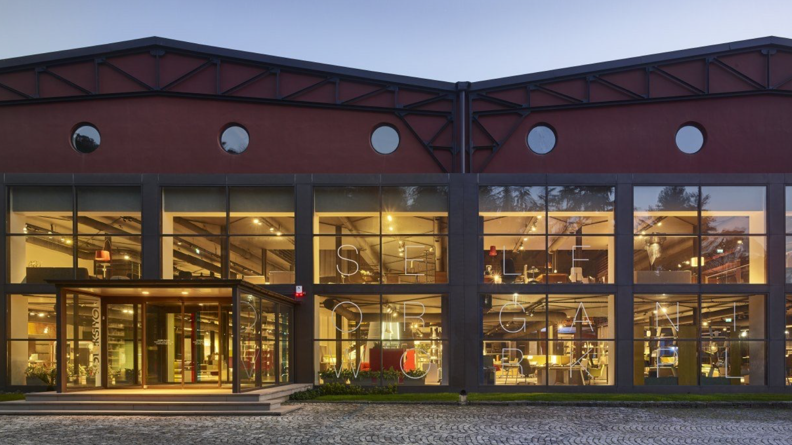
2022

